Slide 1







WELCOME TO FAMILY ORIENTATION
Have Questions
for Our Student Panel?
Scan the QR code to submit your questions anonymously.
Your questions will be answered later during the panel discussion

Slide 2


Family
Orientation
July 23, 2025
“Brass City, Golden Opportunity”
Fumiko Hoeft MD PhD
Campus Dean

Slide 3

Goals
To introduce you to campus resources
To provide you information on how to best support your student
Build trust and reassure you your students are in good hands

Slide 4

Supporting Your Husky: FERPA
Tip:
Remind your student about FERPA and designating access!
Before we can share any specific information about your student with you, they need to give us permission. (there is a brochure in your folder with more information)
Categories Include (but not limited to):
Academic & Advising Info (grades, academic standing, University or School/College supplemental dismissal, etc)
ResLife Info
Student Affairs/Services (volunteer separations and readmissions from/to UConn, requests for incompletes, etc)
Student Conduct (incident reports, case documents, etc)
Student Financial Information (Bursar/Financial Aid)
Tip:
There is more information about FERPA in your folder

Slide 5

Preparing to be a
Successful Student
Set and Prioritizes Goals
Manage time and activities
Utilize resources
Understand academic requirements
Engage with Campus (events, clubs, student groups, and more)
Communicate
Make the effort
Ask for Help
Tip:
Check in on your student and be mindful of what it takes to be successful at UConn

Slide 6

Supporting Your Husky:
Academic Resources
Tip:
Representatives from these resources are available during our Meet & Greet later today!
Tip:
Encourage your student to learn more about our Academic Resources
Learning Lab (Tutoring)
Writing Center
Library
Tip:
Remind your student to be their own best advocate- encourage them to ask for help when they need it
Tip:
Your folders include info on these resources
Academic Achievement Center
Faculty& Staff
RISE & CAPS Programs
Notes:
Tutoring Center- MATH, CHEM, BIOL. Appointments are on a drop-in basis.
Writing Center- Writing Center PDF In person and virtual tutoring sessions available. assists students with essays, lab reports, term papers, academic or creative writing, multimodal projects, résumés, cover letters, and personal statements. Professionally trained peer tutors help students understand writing assignments, organize ideas, fine-tune thesis statements, develop more effective sentences, organize paragraphs, prepare citations, and more.
Library- Our Library services include: Borrowing/checking out materials (the old school library experience), Coordinating inter-library requests (connected to all UConn Libraries as well as libraries world-wide), Course Reserves (some classes reserve materials for their student to access), help with sharing digital work, Request scans of materials not available electronically)- there are also great study spaces in the Library-
Academic Achievement Center- Process tutoring- helping students with everything from Time Management and semester planning, Note-Taking, Test Taking, workshops, Mentoring and others.
UConn Waterbury Faculty- UConn Waterbury has a very supportive faculty. “Office Hours” are made available to students via their instructors.

Slide 7

Tip:
More information about these resources can be found in your folders!
Supporting Your Husky:
Other Resources
Tip:
Encourage your student to learn more about these resources
Center for Career Readiness & Life Skills
Husky Harvest
Spirit Cafe
Center for Students with Disabilities
Student Health and Wellness (SHaW)
Student Activities
Office of Student Services
Tip:
Representatives from these resources will be available at our Meet & Greet later tonight
Notes:
Center for Career Readiness and Life Skills- Our CCD rep will be speaking in a bit- but our CCD is an important part of your student’s path here at UConn. The CCD helps students prepare for their life/career after their degree. Some of the things our CSD does include: Helping students with Networking, Resume building, Internships & Work opportunities and creating important connections across our community
UConn Husky Harvest- In partnership with Connecticut Foodshare, the Husky Harvest Food Pantries' mission is to address food insecurity across UConn. The food pantries are accessible to anyone with a UConn ID and provide the campus community with non-perishable food items, toiletries, and more. Students may browse the pantry during operational hours that vary by campus
Spirit Cafe- In the Rectory Building across the street- only UConn students, Staff and Faculty have access to the Rectory Building- UConnW subsidizes the meals offered- so students can have affordable meal options while on campus.
CSD- You are going to hear more about CSD in a bit- CSD collaborates with students, faculty and staff, and family members to ensure a comprehensively accessible environment- in short, students who request accommodations due to short term to long term disabilities will do so thru CSD.
MHRC-Claudia Pina, our Waterbury Campus Mental Health Resources Center Clinican will speak to you in a bit about our MHRC. Claudia provides our students with confidential supportive counseling. She also helps students look for mental health resources in their community as well.
Student Activities- UConn Waterbury has 11 active student clubs on campus- with room to add more- Nathan Emory is our Student Activities coordinator on campus. Nathan supports our students, their clubs and our Associated Student Government-
Student Services- Offers various services to students- including: rescheduling final exams, campus change requests, student advocacy, academic integrity issues, code of conduct, voluntary separations and re-admissions and others- if a student is unsure where to go to get a question answered, or concern/problem solved- they can contact Student Services. Student Services also includes our professional academic advisors. Many students connect closest and most consistently with their academic advisor- Our professional advisors

Slide 8

Tip:
Never too early to learn about these opportunities
Supporting Your Husky:
Student Enrichment
Learning Communities (LCI and Ideas + Impact)
Experiential Global Learning (Study Abroad)
Undergraduate Research
Student Labor/Work Study
Walkbury
Scholarships
Honors Program
Tip:
Encourage your student to make the most of their time here!
Notes:
UConn Waterbury has scholarships available for UConn Waterbury Students- more information can be found here: https://waterbury.uconn.edu/scholarships/
Other general information about scholarships can be found here: https://financialaid.uconn.edu/scholarships/
Rising Sophomores can apply to UConn’s Honors Program- more information can be found here: https://honors.uconn.edu/regional-campuses/

Slide 9


Supporting Your Husky
Notes:
Now that you have an overview of how we support your student’s success, we want to talk to you about what students are telling us- to prepare you on what they are going to be experience as students here-

Slide 10

supporting Huskies at home
From college to career
Academic Achievement Center

Slide 11

We all have the same goal
Let’s talk about what your student wants you to know as we work together to get there.
Notes:
BOTH

Slide 12



How it can feel (OLs – do you agree?)
STUDENT SERVICES:
we’re somewhat like impromptu drivers ed…
We want them to drive, but they will probably make some mistakes as they learn.
HIGH SCHOOL – get on the bus, someone else takes them where they need to go.
COLLEGE – all of a sudden, they’re expected to know how to drive the bus…

Slide 13
First year of college transitions:
Academic
Students will take a more active role in their learning than they had to in high school and have the ability and know-how to meet the increasing demands of college.
Cultural
Students will interact with/learn from others of various cultures, beliefs, identities, ages, and abilities, in a wide variety of settings.
Emotional
Students will need to be prepared for new challenges/stressors which require them to develop habits and behaviors to cope.
Financial
Students will need to demonstrate basic financial knowledge, an understanding of the costs of colleges, and methods for paying for those costs.
Intellectual
Students will have the opportunity to join an academic community that includes fellow classmates, faculty, and college administrators.
Social
Students will be faced with shifts in their relationships, finding a new peer group and handling the pressure of fitting in.
Dr. Laurie Hazard and Stephanie Carter
Notes:
Jenna

Slide 14

Finding Success at UConn
Five things that your student wants you to know
1. I want you to know about… Major Decision Making
UConn is home to over 115 majors!
The majority of incoming students are considered Academic Center for Exploratory Students (ACES)
ALL majors develop (employable) skills
Time to graduation can be impacted by a students’ choice of major
A large percentage of majors require some sort of application process to get in
2. I want you to know about…
optimal study spaces

Slide 15

I want you to know about…
3. Studying at college
College = 2-3 hours of study time per week per credit.
General Chemistry I is a 4-credit class = 12 HOURS of studying outside of class per week!
Encourage your student to use UConn resources like the Tutoring Center
4. My Priorities: Family, Work, School
Immediate feedback
They want you to be proud of them!
Notes:
3.
Calculus I and General Chemistry I
Information builds on information. ~2-3 hours of study time per week per credit. Calculus/Chemistry are 4 credits = 12 HOURS of studying outside of class per week!
We have a tutoring center, a writing center, an Academic Achievement Center, our faculty hold office hours – but these supports only work if students use them.
4.
UConn Waterbury Students have a lot to balance! Successful students are the ones who learn how to prioritize and how to manage their time
Students need your help when it comes to PRIORITIZING. They will ALWAYS pick their JOB and their FAMILY over their ACADEMICS. It’s also where they often feel SUCCESSFUL
They want you to be proud of them – which means they may not tell you when things go sideways.

Slide 16

5. I want You to know about… the learning that takes place outside of the classroom
SIX COLLEGE EXPERIENCES LINKED TO LIFE PREPAREDNESS
Gallup-Purdue Index finds these six experiences have a stronger relationship to long-term life outcomes such as employee engagement and well-being than the type of school these graduates attended!
75% of those who had all 6 experiences graduated in 4 years
I had at least one professor/staff member (in college) who made me excited about learning
My professors/staff members (in college) cared about me as a person
I had a mentor who encouraged me
I worked on a project that took a semester or more to complete
I had an experience that allowed me to apply what I was learning in the classroom
I was extremely active in extracurricular activities and organizations while I attended (college)
Gallup-Purdue

Slide 17
Even if your student is considering an eventual CAMPUS CHANGE, the CHOICE to ENGAGE here/now
makes all the difference.
STUDIES Consistently SHOW:
student success is DIRECTLY LINKED to student involvement on campus.
Engaged students have a significantly easier time finding a job at graduation.
Most jobs are found through NETWORKING
(college is where your student begins to build their network)

Slide 18
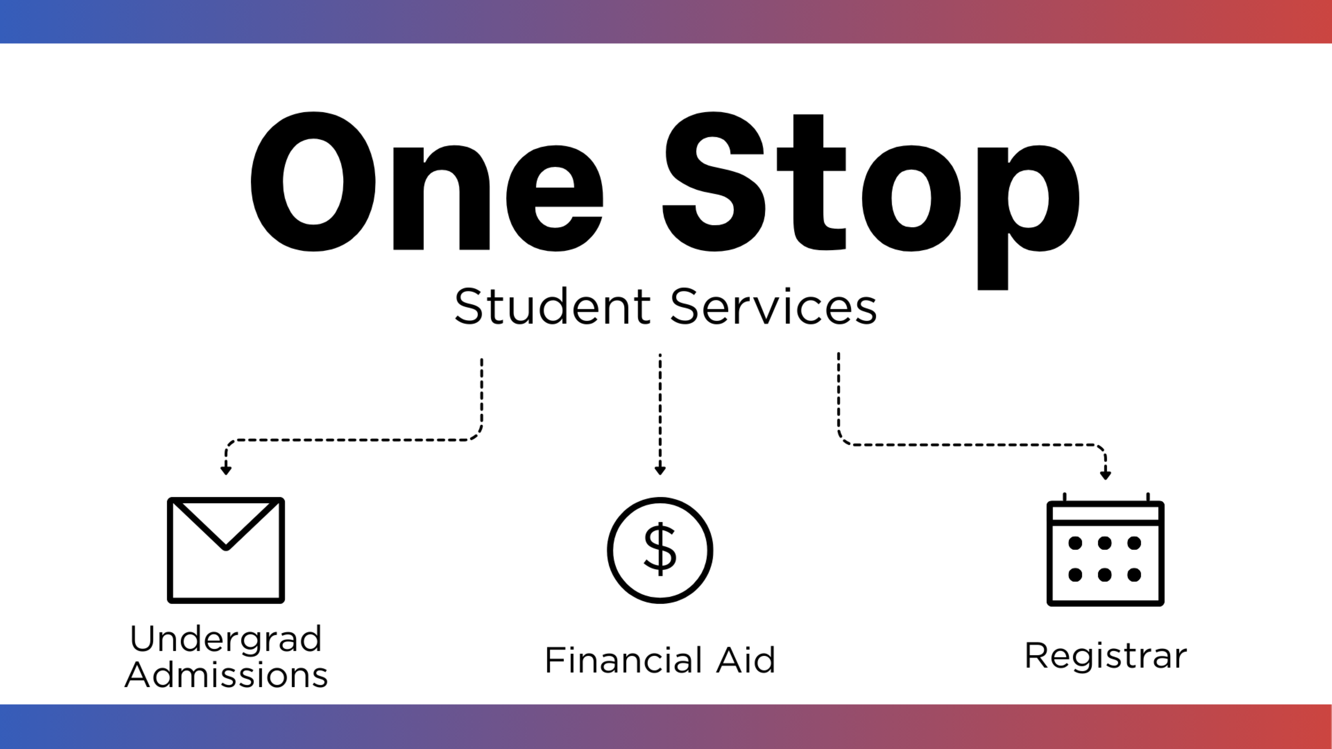
Notes:
Hello, my name is ________________. I'm a _____________ at One Stop Services and I will be the presenter today.
Briefly want to mention our new office: One Stop Student Services​
In order to reduce runaround and get more done for students in one place, we’ve brought the customer service of these three areas under one roof. ​
Office is at Storrs but resources via phone and email are available to students at all campuses. ​
Will be bringing One Stop locations to regional campuses in coming semesters. ​

Slide 19

Agenda
Financial Aid: What You Need to Know
Applying for Financial Aid
Determining Eligibility
Types of Financial Aid: Gift Aid​
Types of Financial Aid: Self-Help​
Employment Opportunities
Maintaining Financial Aid Eligibility
Other Important Item
Contact Information
Notes:
Here are the topics I will be sharing with you today. You can read some or all.

Slide 20


Applying for Financial Aid
To get started with the FAFSA, visit studentaid.gov
Undocumented students will complete the Institutional Aid Application online at https://financialaid.uconn.edu/undocumented_students/.
Visit financialaid.uconn.edu for important information, including application deadlines
Notes:
You are now familiar with how to apply for financial aid, by completing the:
FAFSA or
Institutional Aid Application.
Just two reminders:
1) they need to be completed each year
2) gift aid can be change based on new income/assets information based the Student Aid Index (SAI)
Due every February 15th

Slide 21
Determining Eligibility
Federal Student Aid (FAFSA)
Institutional Aid for Undocumented Students
U.S. Citizen or eligible Non-Citizen
Enrollment or acceptance in an eligible program of study
Accepted into a degree-granting program
Connecticut resident
Common to both applications
Submit by UConn’s on-time deadline of February 15th
Enrolled full-time (12+ credits)
Satisfactory Academic Progress (SAP) compliance
Notes:
To be eligible for Federal Student Aid, there are some eligibility requirements
For the FAFSA
You must be a US Citizen or eligible non-citizen – the FAFSA will ask you questions which determine your citizenship status
You also need to be enrolled in an eligible program of study
To be eligible for Institutional Aid (Undocumented Students), please visit the financialaid.uconn.edu/undocument_student site for specific details on eligibility requirements. Some are:
You must be a Connecticut resident
Attended two years in a Connecticut High School, with a Connecticut High School Diploma
Some common requirements for both applications:
Complete the financial aid application(s) by February 15th
Enroll full time (12+ credits)
Maintain Satisfactory Academic Progress, which will be discussed in a few slides.

Slide 22
Types of Financial Aid: Gift Aid
Grants
Scholarships
Federal Pell Grant
Federal Supplemental Educational Opportunity Grant (SEOG)
Roberta B. Willis Need-Based Grant (CT Residents)
University Grant
Roberta B. Willis Need-Merit Scholarship (CT Residents)
UConn Merit Scholarship
UConn Departmental Scholarship(s)
Private/Third Party
Notes:
Gift aid also referred to as “free money” is awarded to students, and the award does not need to be repaid. These are automatically accepted for you, since I’m sure you don’t want to decline free aid. ​
​
UConn issues the most University Grant upfront. If we get additional funding like SEOG or RBW Need based Grants, we will add in those awards and reduce the UGrant. ​
If you receive a private scholarship, you can report via the Bursar.uconn.edu site to have it deferred on your fee bill.

Slide 23

Types of Financial Aid: Self-Help
Federal Student Loans
Federal Direct Subsidized (student is borrower)
Federal Direct Unsubsidized (student is borrower)
2025-2026 interest rate, 6.39% fixed; will change every July 1st
Student completes Entrance Counseling and Master Promissory Note via studentaid.gov
Repayment: Six months after graduation, separate from UConn or fall below half-time status.
Notes:
Other types of financial aid include self-help aid also referred to as loans ​
​
Both the Federal Subsidized and Unsubsidized loans are in the name of the student​
The Federal Direct Subsidized loan does not accrue interest while you are enrolled at least half time and the Unsubsidized does accrue interest once it is used to pay the bill​
Both of these loans have a current Fixed Rate of 6.39 %​
Repayment occurs 6 months after the student graduates, drops below half-time or withdraws​
Current Origination Fee: 1.057%, which equated to $10.57 per $1,000 borrowed.
Important to note, the US Department of Education adjusts interest rates each July 1st. ​

Slide 24
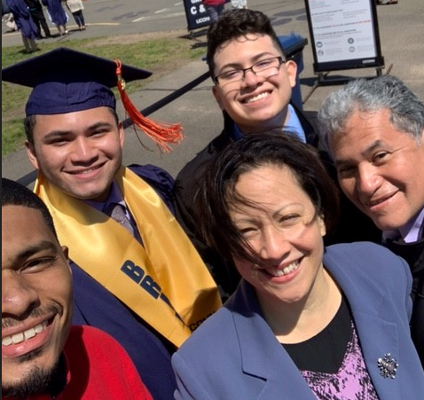
Types of Financial Aid: Self-Help
Other Loan Options
Federal Direct Parent PLUS Loan (parent is borrower), 2025-2026 interest rate 8.94% fixed. Option to repay after Spring disbursement
Private/Alternative Loan – Review interest rate and repayment terms
For additional financing options, visit https://financialaid.uconn.edu/financing-options/
Notes:
Other types of financial aid include self-help aid also referred to as loans ​
​
The Federal Direct Parent PLUS loan is an option available for eligible parents of undergraduate students. You can access the application at studentaid.gov
Current rate is 8.94 % Fixed
Repayment can begin after second disbursement which occurs in January, when you pay the Spring fee bill. You can defer the payment is your student is at least a ½ time student (6 credits) at the university.
​
Current Origination Fee: 4.228%, which equated to $42.28 per $1,000 borrowed.
Important to note, the US Department of Education adjusts interest rates each July 1st
​
Private educational loans are non-federal loans made by private lenders​
Generally, student is the borrower​
Will need a credit worthy co-signer​
Ensure you ask about the interest rate: Variable or Fixed Rate​
UConn’s list of suggested lenders is available on our website financialaid.uconn.edu/altloan

Slide 25
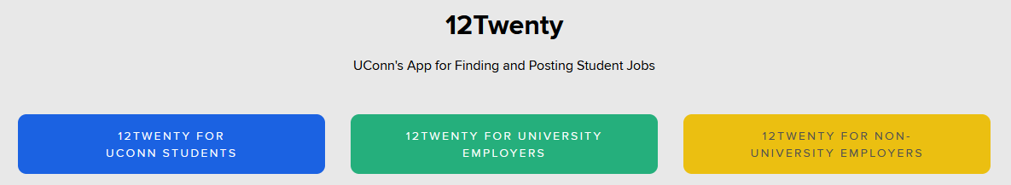
Employment Opportunities
Federal Work-Study
  Employment opportunity funded through the Department of Education
Student Labor
  Employment funded through the department the student is applying with
  Visit https://studentjobs.uconn.edu/ for more information!
Notes:
UConn also has employment opportunities available to our students. ​
​
There is Federal Work-Study, which is typically awarded to students with the most need. This type of employment opportunity is funded through the Department of Education. ​
There is also Student Labor, which is funded through the department in which you are seeking employment. ​
​
You can search available positions online by visiting studentjobs.uconn.edu and choosing the blue link “12TWENTY For UConn students” ​
​
Students who are not offered work-study, still have the opportunity for employment through student labor category. ​
​
An important item to remember regarding work-study and student labor is that income earned is not applied to the fee bill instead, students will receive a paycheck for hours worked.

Slide 26

Satisfactory Academic Progress (SAP)
Terms and Conditions:
Maintain a cumulative GPA of 2.0
Pass 67% of the cumulative attempted credits
Evaluation takes place at the end of each Spring term
Complete a degree program in maximum timeframe
Notes:
Satisfactory Academic Progress or SAP and PACE are important components of your students financial aid offer.
Students must maintain cumulative GPA of 2.0
Another component of SAP is PACE. PACE is the number of hours attempted versus what is completed. At UConn, students must pass 67% of the cumulative attempted credits.
For example, say you attempt 24 credits, but you complete 15, then your PACE would be 62% (15/24) and does not meet the required 67% of the cumulative attempted credits. However, if you attempt 24 credits and complete 24 credits, your PACE would be 100%.
We review student’s progress each May which is the end of the spring term, after grades are posted. If your student is cited for SAP, there is an appeal process in place.
Students will receive an email in May which provides the appeal timeframe and strict deadlines. Please keep in mind that the more your student appeals the less likely they are to be approved. If a student fails to meet SAP, they will no longer be eligible for Federal or Institutional aid.

Slide 27
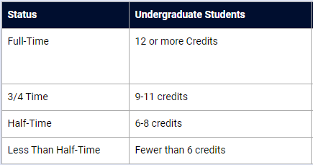
UConn’s Fixed Enrollment Date
Terms and Conditions:
Financial aid offers are dependent on full-time status as of 10pm on the 10th day of classes
Student’s must maintain 12+ credits each semester to keep entire aid offer
Student who are less than 12 credits, will have their aid adjusted, including:
  University Grants
  Merit Scholarships
  Federal Work-Study
  Federal Pell Grants
  Federal Loans
Notes:
Day 10 also referred to as UConn’s fixed enrollment date is the10th day of classes in each semester.
Students financial aid offers are created, assuming full-time status, which is 12 credits or more. Students have until 10 pm on this day to add classes through student admin or 5pm to do so in person with the Office of the Registrar.
Should enrollment status drop below full-time on Day 10, financial aid offers will be adjusted (decreased). Students who are not enrolled full-time will not be eligible for; University Grants, Merit Scholarships, or Federal Work-Study.
In addition, Federal Pell Grants and Loans will be reduced to reflect the current Day 10 enrollment status.
Please note, our office sends out reminder emails to impacted students via their university email address, alerting them that their status is not full-time. It is important to either take action and ensure the student is enrolled full-time by Day 10 or complete the .
There is an appeal process in place should a situation arise that prevented your student from registering full-time. The appeal process will be outlined in an email communication, and it is the student’s responsibility to complete the appeal by the established deadline, no late appeals will be accepted.

Slide 28

Verification
Additional information is requested by the Department of Education to process your FAFSA
On the first page of your FAFSA Submission Summary from the FAFSA, you can see if you have been selected for Verification
Files will be verified through Inceptia, email will be received from VGCS@inceptia.org or a postcard to begin the process
Verification must be completed before financial aid is finalized
Notes:
Let us review the verification process.
Students are randomly selected through the Department of Education. If you have been selected, it will be noted on your FAFSA Submission Summary and you will need to submit certain documentation to confirm information on the FAFSA. Examples of documentation may include income information like a W2 form or 1040 federal tax return, household size, or number in college form, to name a few.
We have established a partnership with Inceptia to expedite the federal verification process. Verification Gateway from Inceptia is an online portal to guide students and parents through verification.
If your FAFSA is selected for verification by the US Department of Education, you will receive an email from VGCS@inceptia.org, or a postcard from Inceptia containing University of Connecticut’s unique website link to start the verification process.
At UConn, your aid will not disburse to your fee bill until the Verification process is complete. Please submit your documents as soon as they are requested.

Slide 29
Special Circumstance
Changes in employment status (2025)
Changes in family structure (e.g. death, divorce or legal separation)
IRA/Pension Withdrawal (2023)
Changes in untaxed income (e.g., child support)
Unusual medical/dental expenses not covered by insurance; cost associated with natural disaster (2023)
Notes:
We also understand that your family’s financial situation may have changed from when you first completed your FAFSA, which this year used 2023 Tax information.
Here are a few circumstances we would consider.
Should you have a special circumstance please visit: financialaid.uconn.edu/appeals and contact our office to begin the Special Circumstance process

Slide 30
Other Important Item
FERPA
  Family Educational Rights and Privacy Act (FERPA)
  Visit ferpa.uconn.edu for details & set up
  Have your FERPA Code when you contact our office via email, phone call or if you pay us a visit
Notes:
Lastly, as a matriculated student, One Stop Services adheres to the Family Educational Rights and Privacy Act (FERPA) which safeguards students' educational records
In order for any office to communicate about a student’s record, a FERPA code is required. Details about FERPA policy are available at ferpa.uconn.edu.
Please have your student set up with a FERPA code before contacting us. Without it, we are unable to provide specific information about your student.

Slide 31

Questions?
Contact One Stop Student Services
Our office is open 12 months a year; Monday through Friday, 8am-5pm
Email – onestop@uconn.edu
Telephone – (860) 486-1111
In person – on a drop-in basis
  No appointment is necessary
Website – onestop.uconn.edu
Notes:
Read the information from the slide.

Slide 32
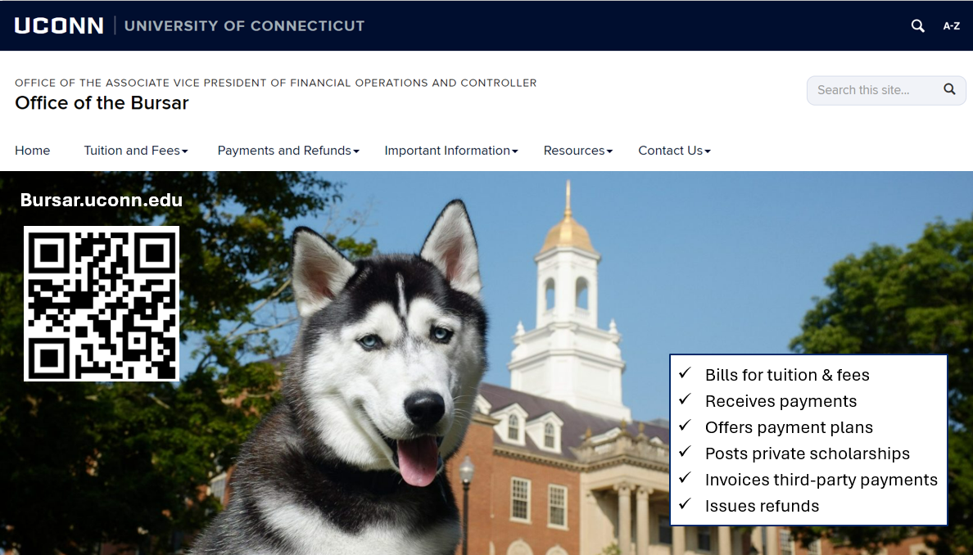

Agenda
Notes:
Here at UCONN, the Office of the Bursar bills for tuition and fees. Receives payments, offers payment plans, post private scholarships, invoices third party payments and issues refunds for overpayments on a student’s account.
Students might have overpayments refunded to them to pay for living expenses and or school supplies.

Slide 33

Agenda
Undergraduate Fee Bill Due Dates
Fun Fact!
UConn was founded in 1881, which determined the undergraduate fee bill due dates.
1881 is the year UConn was founded!
Spring bills are due January 8th (1/8)
Posted mid-November
Fall bills are due August 1st (8/1)
Posted mid-June
Fee bills are issued electronically ONLY to the uconn.edu email address.
Email notifications may include…
When fee bills are issued
Due dates
Payments received
Changes in account
Notes:
Fun Fact! …………………….UConn was founded in 1881, which determined the undergraduate fee bill due dates.
Fall fee bills are due August 1st (8/1) and are typically generated early to mid June.
Spring fee bills are due January 8th (1/8) and are typically generated in mid-November
It is very important to note that tuition bills are issued electronically ONLY to the students uconn.edu email address. Students will receive email notifications regarding when fee bills are issued, due dates, payments received and changes in their account. Parents and Guardians who become Authorized Users BEFORE the fee bill releases will receive a notification that the fee bill is ready to view, they can make a payment, enroll in a payment plan and other helpful reminders regarding the fee bill. If an Authorized User does not receive the email notification, the student may forward the email they received to the Authorize User. The information will also be available on our website, bursar.uconn.edu under the “Resources” tab. Closer to the due date, students and Authorized Users who have not paid their balance will receive another notification, so students must set up parents and guardians to become Authorized Users if they wish to receive the following information. Fee bills are also available to view 24/7 through Student Administration and the Flywire payment portal.

Slide 34
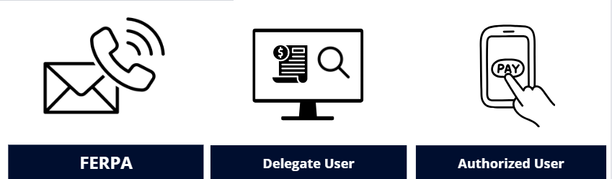



Agenda
Payment Options
Electronic Payments
E-check (ACH)
Credit & Debit Card (2.75% Convenience fee)
Fidelity CHET (Under ACH option)
Bill Pay
Wire transfer –Partnered with Flywire (International Students- No US bank account or US address)
Mail-In Paper Checks
Check, Money Order & 529 Payments (No Cash Accepted)
529 account holder must contact the plan provider to send payment
Payments MUST be sent 2-4 weeks before due date to avoid receiving holds and late fees to the address below
University of Connecticut
233 Glenbrook Rd, Unit 4100
Storrs, CT 06269
MUST include UNIT 4100 in address, students name and PeopleSoft ID on check
Payment Plans
Notes:
There are multiple ways to pay the fee bill.
Electronic payment options are the fastest and most secure methods of payment. To make a payment online, visit our website to login to be directed to the payment portal.
E-checks, or electronic checks, uses your banking information to process a secure payment online. Here you will enter your routing and account bank numbers. There is no fee to pay via e-check.
Credit and debit cards can be used online as well. To use a debit or credit card, you will be charged a 2.75% convenience fee.
If you wish to pay the fee bill with your Fidelity 529 College Savings Plan, you will need to login to Flywire and select the ACH option. For other 529 College Savings Plans you may now have an electronic option with the provider which saves time and improves transparency with real-time payment tracking. When requesting a withdrawal from your plan, look to see if your provider can electronically send a payment to UConn. If the option is not available, the 529 College Savings Plan provider will need to send a paper check by mail.
University of Connecticut is partnered with Flywire offering students the ability to pay their fee bills with foreign currency via an international account. Students and Authorized Users can login to the payment portal to make a wire transfer. UConn DOES NOT give out banking information and we can only track payments made through Flywire.
Payees can still mail a check, bank check, money order, or a 529 payment. If the payment is being delivered by mail, the payment can take up to 2 weeks depending on the mail system. It is important that these payments including 529s, are sent 2-4 weeks before the fee bill due date to avoid late fees and holds on the student's account. Please note when paying with a 529 plan, you must request a 529 check from your 529 plan provider. The mail payments can be sent to…..
University of Connecticut
233 Glenbrook Rd, Unit 4100
Storrs, CT 06269
When mailing a payment, the address MUST include UNIT 4100. If the address is missing 4100, we will not receive this payment.
If the payee wishes not to mail the payment, a drop box can be found on the Storrs Campus in the Wilbur Cross Building or any regional campus. All payments being mailed or placed in the drop box, MUST include students name and ID. If the payment is missing the name and ID, we cannot post the payment to the account.
Please note we do not accept cash or payments over the phone.

Slide 35
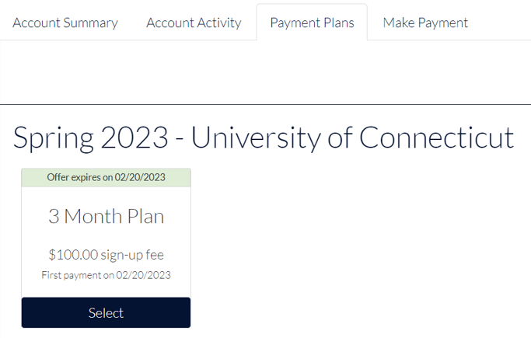
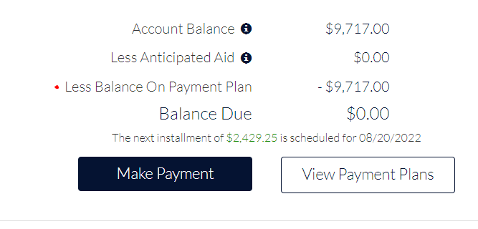

Agenda
Payment Plans
Fall & Spring ONLY
Interest Free
5, 4 & 3 Installment Payment Plans (based on date plan was entered)
$100 Non-Refundable to activate semester plan
Additional Information:
Balance of $300+
Previous semester MUST be paid off
U.S. Payment Plans: Automatic monthly withdrawals
  Routing/Account # (ACH) , Credit & Debit Card (2.75% fee), CHET accounts
International Payment Plans: Manually initiates payment ahead of installment due date every month
  Wire transfer
NO checks and NO cash allowed
10th Day of semester classes is the LAST DAY to ENROLL
MUST enroll by the fee bill due date to avoid Bursar Holds and late fees
(Year)
Notes:
UConn offers Fall and Spring 5,4 and 3-month interest-free payment plans as an alternative to one large payment to help limit loan borrowing and ease financial pressures. UCONN does not offer payment plans for the summer and winter sessions. Students and designated Authorized Users may enroll in a payment plan to pay for eligible student charges. If a student or Authorized User wishes to set up a 5-month installment plan, they will need to sign up when fee bills are issued. After each enroll by due date, the amount of payment plan offers decrease, so we recommend signing up early.
To qualify for the payment plan, your account must be in good standing. All outstanding balances must be paid off first. However, any student who owes more than $300 for the current term may enroll. While the plan is interest free, there is a $100 non-refundable sign-up fee for the Fall and Spring plans. UConn only offers fall and spring payment plans. We do not offer winter and summer payment plans.
Students and Authorized Users with a U.S. bank account linked to a U.S. address must be willing to allow the installments to be taken out automatically from a personal U.S. checking account or scheduled charges to a debit or credit card. International payment plans require the student or Authorized User to login to manually initiate the payment ahead of the payment plan installment due date.
If you receive financial aid, loans, grants or awards after your payment plan is created, your account will rebalance showing your new installment amounts.
If the student or Authorized User misses the installment date, the student will then be removed from the payment plan causing a balance due on their account, risk receiving Bursar Holds and up to $300 in late fees.

Slide 36



Agenda
Mandatory Health Insurance Options
  Personal health insurance
  Plan carried by their parents
  University Sponsored Health Insurance (Full year)
Waiving University Sponsored Health Insurance
  Optional to waive fee off bill
  Must have health insurance
  Student Admin > Bursar > Waivers > Health Waiver
  No waive, must pay
  Waive by:
      Fall Semester- September 15th – (Billed for 1 year)
      Spring Semester- February 5th –(Billed ½ year- Newly admitted students)
Notes:
Full-time students are required to carry health insurance. If the student is covered under another plan and they do not wish to enroll in the University sponsored health insurance plan, the health insurance waiver must be completed every year in the fall by September 15^{th.} For newly admitted students that will be starting in the spring, they will be billed for half of the insurance. The newly admitted spring student will need to waive the health insurance by February 5th.
In the Fall, the student will then be charged the full amount. The waiver only covers one academic year at a time. If the student does not waive the health insurance, they are financially responsible.
The student will log in to Student Admin to upload proof of current health insurance and complete the waiver.

Slide 37


Agenda
Husky Book Bundle Fee
Partnership with Barnes & Noble Bookstore
Reduces cost of traditional textbooks up to 50%
Available to full-time, part-time & non degree undergrad students.
Tier fee structure (Prorated based on enrolled credits)
Rental Fee charged to the fee bill per semester
Covers required course materials
Waterbury campus has no bookstore, so students must select to have the books shipped to their home; students cannot pick up their books on campus
Rental books are due last day of finals
Opt out opens 30 days prior to 1st day of class & opt out ends on the 10th day of class if student wishes to purchase books on their own
For more information visit: bookbundle.program.uconn.edu
Notes:
Husky Book Bundle Program is through a partnership with UConn Barnes & Noble Bookstore.
Reduces cost of traditional textbooks up to 50%.
The Husky Book Bundle is available to all full time, part time and non degree seeking undergrad students and is a Rental Fee that is charged to the fall and spring fee bill covering all the require course materials.
The book bundle is a tier fee structure, meaning the fee is prorated based on enrolled credits.
Student may have their books mailed or they can pick up their books before the first day of classes. The books will then need to be returned by the last day of finals.
If the student does not want the Husky Book Bundle, they MUST opt out 30 days prior to the 1st day of class. The opt out portal will close on the 10th day of class. If the student wishes not to utilize the Husky Book Bundle, the student will then be responsible to purchase their textbooks on their own.
Please note, students will receive an email from the bookstore with a link to view mandatory textbooks and choose a delivery method for their materials. For convenience, the link to opt-out is also available through the students “Quick Links” section in the fee bill payment portal.
For more information visit bookbundle.program.uconn.edu.

Slide 38
Agenda
What are Federal Title IV Funds?
Title IV Funds = Federal Student Aid Funds
Federal student aid programs administered by the U.S. Department of Education
Title IV Funds include:
Direct Subsidized/Unsubsidized Loans
Direct Plus & Direct Graduate PLUS Loans
Federal Pell Grants & Federal Supplemental Educational Opportunity Grants
What charges does Federal Student Aid Funds pay for?
The U.S. Department of Education regulations only allow schools to use your Federal Student Aid to pay for current academic year institutional allowable charges, unless you have granted permission to apply these funds to non-allowable charges as well.
Allowable charges:
Tuition
Mandatory fees
University Room & Board
Non-Allowable/ Miscellaneous charges include:
Health insurance
Husky Book Bundle
Husky One Card charges
Health service/lab fees
Parking & Library fines
Notes:
Title IV funds are federal student aid funds, which are from federal student aid programs administered by the U.S. Department of Education. The U.S. Department of Education regulations only allow schools to use federal student aid to pay for current academic year institutional charges unless the student has granted permission to apply these funds to non-institutional charges. UConn can only apply Title IV aid to allowable charges such as tuition, mandatory fees, room and board contracted with the university.
Non-Allowable Miscellaneous charges may include UConn Sponsored Health insurance, Husky Book Bundle, Husky One Card charges, Health service, lab fees, Parking and Library fines.

Slide 39

Title IV Waiver
What is the purpose of Title IV Waiver?
Completing the Title IV Waiver, you are agreeing to authorize Title IV Funds (Federal Financial Aid) to be applied to all charges!
"I wish to authorize use of my Title IV financial aid funds to pay any and all charges within the academic year."
Example- Student completed the Title IV Waiver
Student is receiving financial aid.
Student completed the Title IV Waiver.
Enrolled in the Husky Book Bundle.
Financial Aid is allowed to cover the Husky Book Bundle.
Example- Student DID NOT complete the Title IV Waiver
Student is receiving financial aid.
Student did not complete the Title IV Waiver.
Enrolled in the Husky Book Bundle.
Financial aid is NOT allowed to cover the Husky Book Bundle.
Student may receive a refund for Husky Book Bundle.
Student NOW RISKS OWING back the Husky Book Bundle Fee.
Student will then need to pay off balance even though they received a refund.
** Regardless if you have completed a Title IV Waiver, the following charges are never allowed to be covered.
  (One Card charges, Parking Fines, Health Service Fees, & Late Fees)
Don’t forget to complete the Title IV Waiver!
Notes:
By completing the Title IV waiver, you are agreeing to authorize Title IV Funds (Federal Student Financial Aid) to be applied to ALL charges. This includes allowable and non-allowable charges mentioned on previous slide.
IF the form is NOT completed BEFORE financial aid is placed on the fee bill, the student may RISK owing a balance. Please see examples below.
Example- Authorizing
Student is receiving financial aid.
Student completed the Title IV Waiver.
Enrolled in the Husky Book Bundle.
Financial Aid is allowed to cover the Husky Book Bundle.
Example- Not Authorizing
Student is receiving financial aid.
Student did not complete the Title IV Waiver.
Enrolled in the Husky Book Bundle.
Financial aid is NOT allowed to cover the Husky Book Bundle.
Student may receive a refund for Husky Book Bundle.
Student NOW RISKS OWING back the Husky Book Bundle Fee.
Student will then need to pay off balance even though they received a refund.
Common question. Does the authorization form need to be signed each year?
No. The authorization remains in effect while a student at UConn. It may be changed by sending an email request to the Bursar’s Office. To avoid being refunded and owing back, please complete the Title IV Waiver BEFORE financial aid disburses to the fee bill.

Slide 40
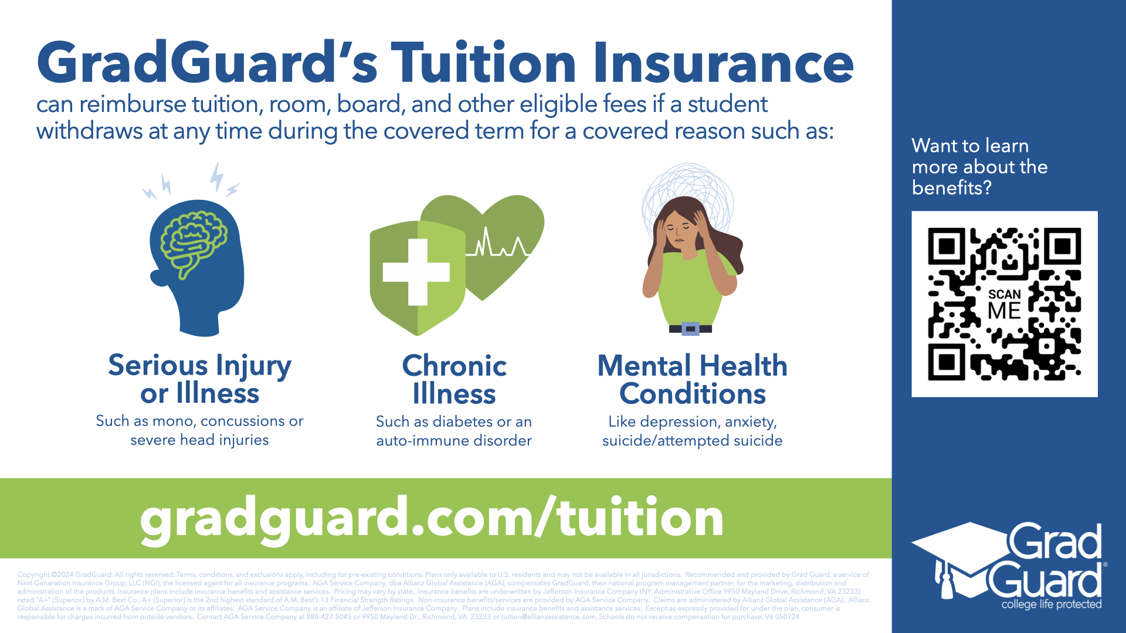

Agenda
Grad Guard’s Tuition Insurance
Can reimburse tuition, room, board and other eligible fees if a student withdraws at any time during the covered term for a covered reason such as:
Notes:
UConn offers tuition insurance through Grad Guard. The tuition insurance can reimburse tuition, room, board and other eligible fees if a student withdraws at any time during the covered term for a covered reason such as:
Serious Injury or Illness
Chronic Illness
Mental Health Conditions
For more information, please scan the QR code and or visit gradguard.com/tuition.

Slide 41
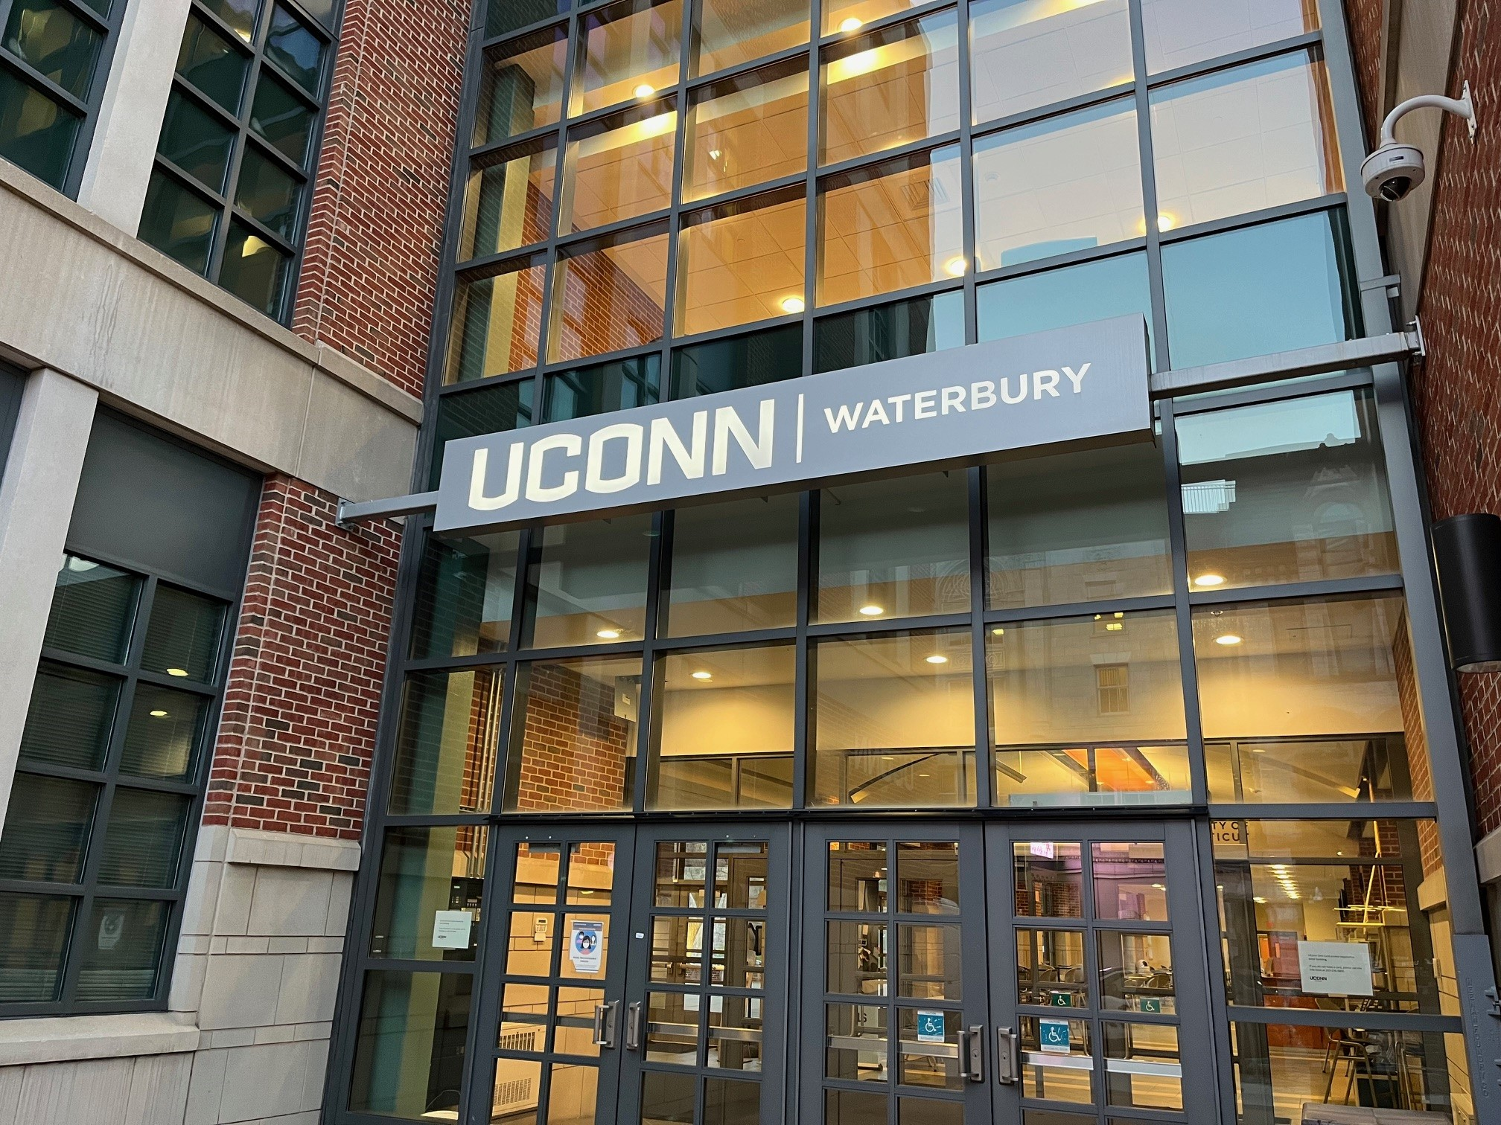
UConn Waterbury Contact Information
Our office is open 12 months a year; Monday through Friday, 9am-4:30pm
Email – cynthia.jurzynski@uconn.edu or waterburybursar@uconn.edu
Telephone – (203) 236-9819
In person – on a drop-in basis
  Helpful to check in ahead for availability
Notes:
Read the information from the slide.

Slide 42

UConn
Public Safety
Encourage Mindfulness
LiveSafe - NEW | Police Department
Emergency Blue Phones
Full Campus Police Coverage
Stats can be found here:
  https://police.universitysafety.uconn.edu/clery-annual-security-report/
On Campus Parking with secure buildings (One Card swipe access)
Notes:
LiveSafe is an app that promotes and encourages safety on your college campus. Our goal is for students to be able to communicate directly to dispatchers and campus public safety officials quickly and comfortably in their time of need.

Slide 43
STUDENT PANEL
Aisha Khan- Psychological Sciences
Ania Hashmi- English
Aylanie Bonilla- Communication
Doris Cajamarca Bravo- Business Admin
Maryel Mendoza- Exploratory
Neisha Sanchez- Environmental Sciences
Nick Ho- Urban & Community Studies
SCAN HERE TO SUBMIT A QUESTION!

Slide 44
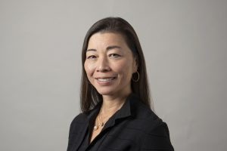


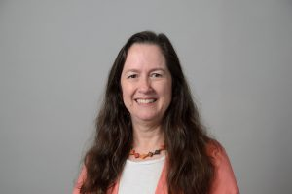



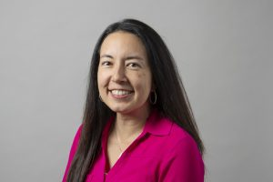




Dr. Fumiko Hoeft
Campus Dean
Peter Tribuzio
Director of Student Services
Karima Jackson
Academic Achievement Center
Cindy Jurzynski
Student Financials
Alex Ali
Learning Communities
Tony Omega
Academic Advisor
Alyssa Boucher
Academic Advisor
Nicole Ariyavatkul
R.I.S.E. Program
Rachel Julian
Disabilities Coordinator
Nicole McKelvey-Walsh
Student Health & Wellness
Tess Clark
Admissions
Monica Lattimer
Campus Operations

